Slide 1

Object-oriented Programming with Ruby
Robert Batzinger
CSCI A-201
Spring 2009

Slide 2
Basic Input and Output
Getting data from the keyboard or a file

Slide 3
Data entry through the Console:
String I/O
Character I/O
Input: my_name = gets
Output:
print ‘My name is:’
puts my_name
Input: next_char = getc
Output: putc 65 putc ‘A’ putc next_char

Slide 4
The default I/O is through STDIO
Default
Same as
print a
puts a
a = gets
STDIO.print a
STDIO.puts a
a = STDIO.gets

Slide 5
Console as a character device
Can only print characters or strings of characters
Other data types must be converted to strings
If the data type has a to_s method the conversion is automatic
Other methods exist to create representations of complex data types as strings
puts 3.14159
puts ‘Roses are red!’
buffy = Cat.new(‘Buffy’)
p buffy

Slide 6
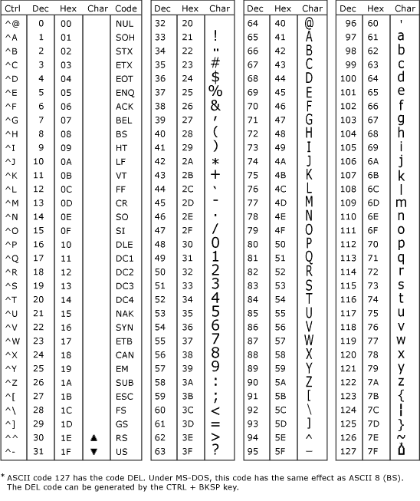
Character codes
ASCII:
7 bit codes (0-127)
Basic printing and communications control 0-31
Standard Roman characters 32-127
UNICODE
Several bytes
Encodes major languages of the world
UTF-8; UTF-16

Slide 7
Values of things you type
When you type, the corresponding character values are stored in sequence
If you have type enter at the end of the string, the line feed character has been entered
Program puts ‘Your name: ‘ a = gets
View onscreen: Your name:
B o b (enter)
Contents of a 66 111 98 10

Slide 8
The context for data conversion
Operations are applied left to right
Use parenthesis and explicit conversion methods when necessary
puts ‘a‘ + ‘b’ ab
puts 1 + 2 3
puts ‘a‘ + 1 error
puts ‘a‘ + 1.to_s a1
puts ‘a’ + (1 + 2).to_s
a3

Slide 9
The console is attached to standard input
Data stored in files could be used as input
Output to the screen could be redirected for storage in a file
The command line syntax determines the direction
ruby copy.rb
In: keybrd Out: screen
ruby copy.rb <file1
In: file1 Out: screen
ruby copy.rb >file2
In: keybrd Out: file2
ruby copy.b <file1 >file2
In: file1 Out: file2

Slide 10
6 ways to copy a file
STDIN.each_byte { |x|
putc x
}
_______________________
STDIN.each_line {|x|
puts x
}
_______________________
STDIN.readlines.each { |x|
puts x
}
while ! STDIN.eof?
x = getc
putc x
end
while ! STDIN.eof?
x = gets
puts x
end
myfile = File.open('poem.txt')
myfile.each { |x|
puts x
}

Slide 11
The File class
The File class is part of the default Ruby library
Allows for the opening and closing of files as input and/or output streams as per the file open parameter
Can be used to open and process several files at once
The File class is a subclass of the IO class providing access to the file on the character, line, block and whole file basis depending on the method chosen.

Slide 12
File open parameters
r – read from the top to the bottom
w- write over the file
w+ - read/write and supports addressing
a – append to the bottom
b – binary mode for DOS/MS Windows

Slide 13
File I/O methods
Size of I/O | Input | Output
Character | getc | putc
String | gets | print / puts
Line | readline | puts
Block | sysread | syswrite
File | readlines | write

Slide 14
File maintenance methods
File.unlink(file1) – deletes File1
File.rename(file1,file2) – rename File1 as File2
File.size(file1) – returns the number of bytes in File1
File.exists?(file1) – checks if File1 exists
File.mtime(file1) – returns the time of the last modification of File1
File.directory?(file1) – checks if File1 is a directory
File.file?(file1) – checks if File1 is a data file

Slide 15
Directory class
Allows Ruby programs to
Open a file directory on the hard drive
Read all the file names
Navigate to another directory
Can be combined with File class to enable Ruby to work through the entire collection of files on a hard drive

Slide 16
Reading all files in a directory
d = Dir.new('.') # Open a directory
d.each do |x| # Search through each directory entries
puts "File: #{x}"
puts '-------------------'
if (File.file?(x)) # Check if the entry is a file
f = File.open(x) # open the file
f.each_line do |y| # on a line by line basis
puts y # output the line
end
puts ‘-------------------'
f.close # close the file
end
end

Slide 17
Built in classes extend I/O to other media
Pipes – between the output of one program and the input of another
Sockets – between a program and a service on a server on the internet
HTTP – between a program and websites
FTP – between a program and a collection of files

Slide 18
おわり The end

